Slide 1
DEPARTMENT OF PHYSICS
SRM INSTITUTE OF SCIENCE AND TECHNOLOGY
18PY103J – Physics: Semiconductor Physics
Module-III, Lecture-16
Numerical based on Solar Cell & Electrical Conductivity
18PYB103J Module-III Lecture-16

Slide 2
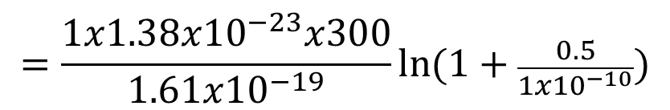


Numerical based on Solar Cell
& Electrical Conductivity
Solved Numerical:
Determine the Open-Circuit Voltage V_{oc} of the solar cell, if Saturation Current (I_{s}) = 1x10⁻¹⁰ A, Light Generated Current(I_{L}) = 0.5 A, Ideality Factor (n) =1, and Temperature (T) = 300 K
Solution:
Open-Circuit Voltage
$${ V}_{OC}=\frac{nkT}{q}\ln{(1+\frac{I_{L}}{I_{S}})}$$
$$=\frac{1x{1.38x10}^{−23}x300}{1.61x{10}^{−19}}\ln{(1+\frac{0.5}{{1x10}^{−10}})}$$
$$=0.57V$$
18PYB103J Module-III Lecture-16

Slide 3



Numerical based on Solar Cell
& Electrical Conductivity
Determine the Fill Factor FF of the solar cell, if Short-Circuit Current (I_{sc}) = 2.75 A, Open-Circuit Voltage (V_{oc}) = 0.6V, Current at Maximum Power (I_{m}) = 2 A and Voltage at Maximum Power (V_{m}) = 0.5V
Solution:
Fill Factor
$$FF=\frac{I_{m}V_{m}}{I_{sc}V_{oc}}$$
$$=\frac{2x0.5}{2.75x0.6}$$
$$=0.606$$
18PYB103J Module-III Lecture-16

Slide 4
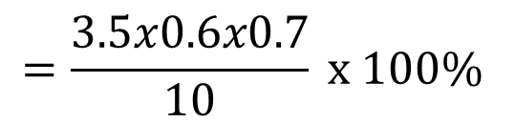
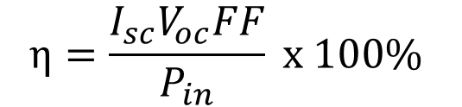

Numerical based on Solar Cell
& Electrical Conductivity
Determine the Conversion Efficiency η of the solar cell, if Short-Circuit Current (I_{sc}) = 3.5A, Open-Circuit Voltage (V_{oc}) = 0.6V, Fill Factor (FF) = 0.7 and Input Power (P_{in}) = 10W
Solution:
Efficiency
$$η=\frac{I_{sc}V_{oc}FF}{P_{in}} x 100\%$$
$$=\frac{3.5x0.6x0.7}{10} x 100\%$$
$$=14.7\%$$
18PYB103J Module-III Lecture-16

Slide 5

Numerical based on Solar Cell
& Electrical Conductivity
Determine the Conductivity (σ) of the Intrinsic Semiconductor. The given parameters are: μ_{e} = 0.145 m²/V-s; μ_{h}= 0.055 m² /V-s; n_{i}= 1.5625×10¹⁶/m³ ; q = 1.602×10⁻¹⁹ C.
Solution:
Conductivity
$$σ=ne{[μ}_{h}+μ_{h}]$$
$$=1.5625x{10}^{16}x1.602x{10}^{−19}[0.145+0.055]$$
$$=5.0x{10}^{−4}mhos/m$$
18PYB103J Module-III Lecture-16

Slide 6

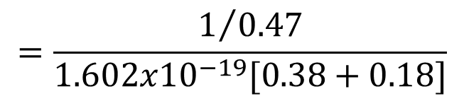
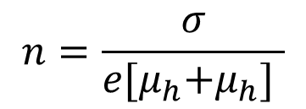
Numerical based on Solar Cell
& Electrical Conductivity
The resistivity of intrinsic germanium at 300 K is 0.47 Ωm. If the electron and hole mobilities are 0.38 m²/V-s and 0.18 m²/V-s, then calculate the Intrinsic carrier density (n) at 300 K.
Solution:
Conductivity
$$σ=ne{[μ}_{h}+μ_{h}]$$
$$n=\frac{σ}{e{[μ}_{h}+μ_{h}] }$$
$$=\frac{1/{0.47}}{1.602x{10}^{−19}[0.38+0.18]}$$
$$=2.3x{10}^{19}m^{3}$$
18PYB103J Module-III Lecture-16

Slide 7
Numerical based on Solar Cell
& Electrical Conductivity
Unsolved Problems:
Determine the Open-Circuit Voltage V_{oc} of the solar cell, if Saturation Current (I_{s}) = 0.75x10⁻¹⁰ A, Light Generated Current(I_{L}) = 0.65 A, Ideality Factor (n) = 0.9, and Temperature (T) = 310K. [Ans: V_{oc} = 0.55V]
Determine the Fill Factor FF of the solar cell, if Short-Circuit Current (I_{sc}) = 2.25 A, Open-Circuit Voltage (V_{oc}) = 0.75V, Current at Maximum Power (I_{m}) = 1.5 A and Voltage at Maximum Power (V_{m}) = 0.85V. [Ans: FF = 0.7556]
Determine the Conversion Efficiency η of the solar cell, if Short-Circuit Current (I_{sc}) = 2.8A, Open-Circuit Voltage (V_{oc}) = 0.55V, Fill Factor (FF) = 0.8 and Input Power (P_{in}) = 10W. [Ans: η = 12%]
The following data are given for an intrinsic semiconductor at 27°C; n_{i} = 2.4×10¹⁹m^{–3}, μ_{e} = 0.39 m²/V-s and μ_{h} = 0.19 m²/V-s. Calculate the conductivity of the intrinsic semiconductor. [Ans: σ = 2.22 Ω⁻¹m⁻¹]
18PYB103J Module-III Lecture-16

